Slide 1



ALUMNI DATABASE MANAGEMENT SYSTEM
Name : NITHEESH S.J
Roll No : 23ADR121
Date : 18/11/2024

Slide 2
INTRODUCTION
Purpose:
The purpose of this project is to manage alumni information efficiently by allowing CRUD (Create, Read, Update, Delete) operations through a user-friendly Java application connected to a MySQL database.
Technology Used:-
Programming Language: Java
Database Management System: MySQL
Database Connectivity: JDBC (Java Database Connectivity)
Driver: MySQL Connector/J (com.mysql.cj.jdbc.Driver)
Development Environment: Any Java IDE
ErrorHandling:Java exception handling (SQLException,classNotFoudException)
USER INTERACTION : Java scanner for console based IP/OP
SQL OPERATIONS : Parameterized queries for secure database transcations
.

Slide 3
System Design and Features
SYSTEM DESIGN:
ARCHITECTURE:
Two-tier (Console UI and MySQL database)
CORE COMPONENTS:
ALUMNI (entity class),ALUMNIDATABASE(JDBC-CRUD OPERATIONS),MAIN (menu-driven user interaction).
DATABASE SCHEMA:
TABLE (ALUMNI) WITH FIELDS LIKE (NAME,EMAIL,GRADUATIONYEAR,MAJOR)
FEATURES:
1.ADD ALUMI
2.VIEW ALL ALUMNI
3.SEARCH ALUMNI BY NAME
4.UPDATE ALUMNI DETAILS
5.DELETE ALUMI

Slide 4
Core Functionalities
Add Alumni: Save new alumni records with details like name, email, graduation year, major, and industry.
View All Alumni: Retrieve and display all stored alumni information
Search Alumni: Find a specific alumnus by their name.
Update Alumni: Modify existing alumni details based on their name.
Delete Alumni: Remove an alumnus' record by their name.

Slide 5
Key Components of the Code
.
Alumni Class: Represents alumni
AlumniDatabase Class: Handles CRUD operations using JDBC (add, view, search, update, delete).
Main Class: Provides a menu-driven interface for user interaction and calls database methods.
Database Connection:

Slide 6
Database Design
Database: ndb
Table: Alumni
Columns: id (auto-increment, primary key), name, email, graduationYear, major, currentWorkingIndustry, description
Indexes: email, name
Constraints: Unique email, 4-digit graduationYear

Slide 7
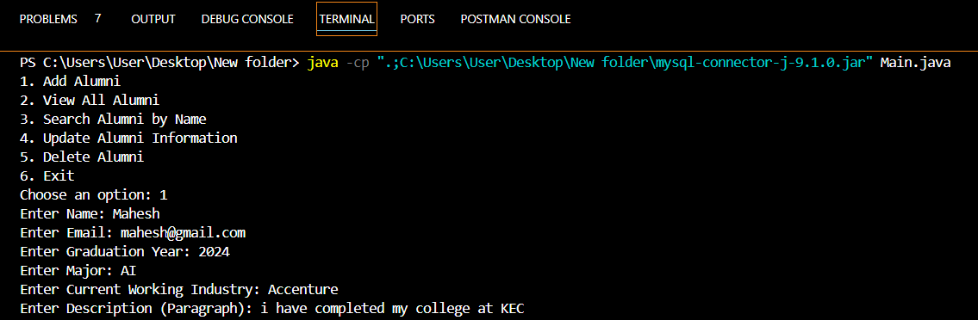
Code Output
View All Functions Offered :

Slide 8
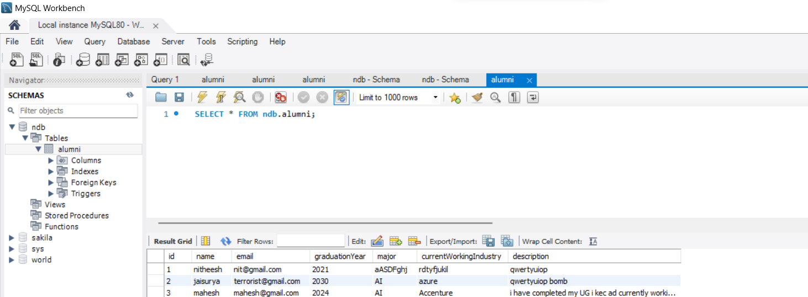
Database Connection:

Slide 9
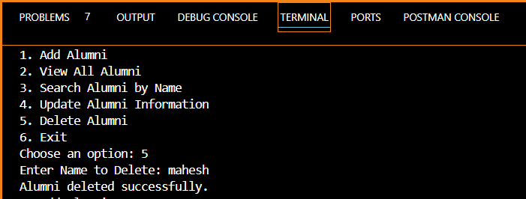
Delete Function:

Slide 10
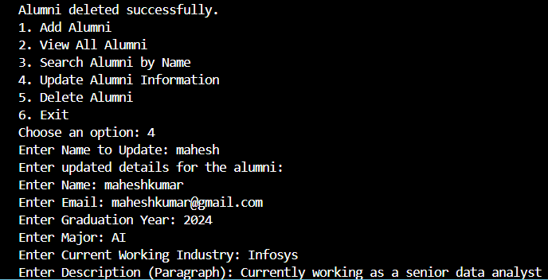
Update Function:

Slide 11
Conclusion
In conclusion, this project effectively manages alumni data by providing a system for adding, viewing, searching, updating, and deleting alumni records. It utilizes Java for the application logic, MySQL for database storage, and JDBC for seamless database interactions. The system is designed to be scalable, easy to maintain, and secure with appropriate validation and indexing in the database.

Slide 12
THANK YOU

